Slide 1



SMART INDIA HACKATHON - 2024
SMART INTERSECTIONS Real-Time Traffic Flow Optimization with AI-Driven Adaptive Signal Systems
Problem Statement ID: SIH1607
Problem Statement Title: A smart AI based solution for traffic management on routes with heavy traffic from different directions, with real-time monitoring and adaptation of traffic light timings.
Theme: Smart Automation
PS Category: Software
Team ID:
Team Name: SLASH 6

Slide 2

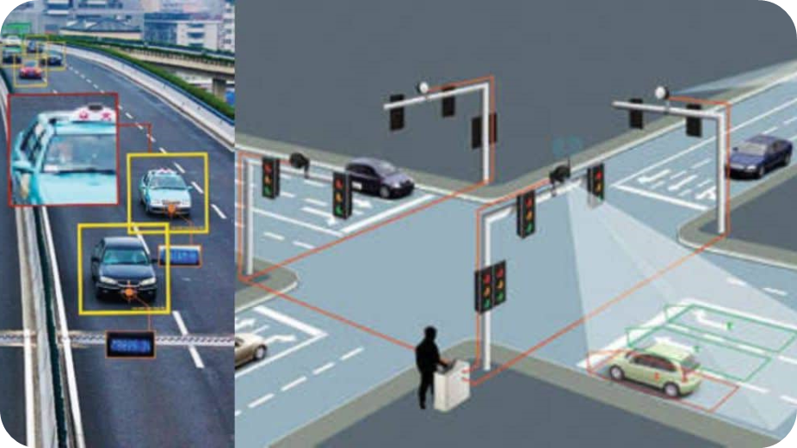
SMART INTERSECTIONS Real-Time Traffic Flow Optimization with AI-Driven Adaptive Signal Systems
PROPOSED IDEA
An AI-driven traffic management system that dynamically adjusts traffic light timings based on real-time traffic conditions, reducing congestion and optimizing traffic flow.
SOLUTION
The system uses cameras to monitor traffic density at intersections, processes the data with AI models, and updates traffic signal priorities for each road based on the level of traffic density every 5 seconds.
PROTOTYPE
A simulation environment demonstrating real-time traffic analysis and adaptive signal control, ensuring smooth traffic flow even in high-density areas.
WHY OUR APPROACH ?
Real Time Adaptation and Decision Making
Coordination of Traffic Signals in an Intersection
Scalable and Flexible
Emergency traffic support for Ambulances

Slide 3


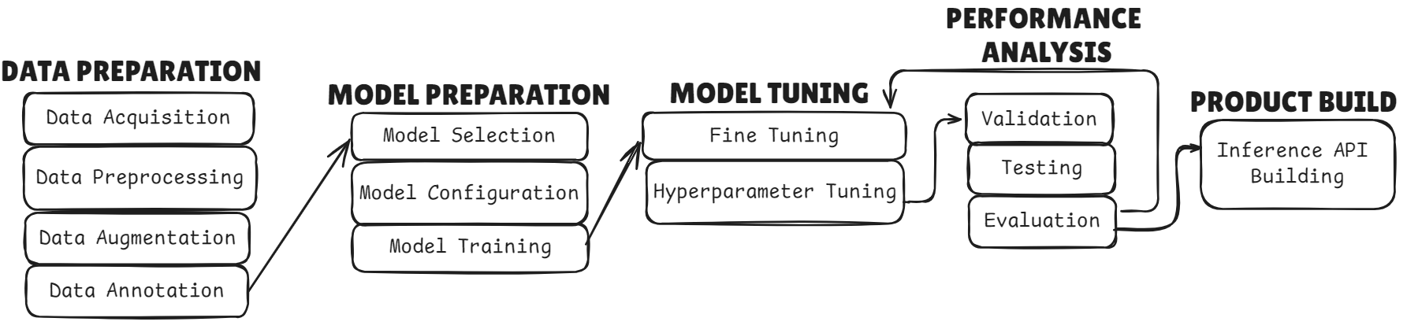
TECHNICAL APPROACH
TECHNOLOGIES USED:
- Primary Language will be Python with C++ build dependency for GPU & CUDA support
- Hardware component like GPU/TPU for model training with CUDA support.
- Deep Learning libraries such as PyTorch, Ultralytics, Torchvision .
- Frameworks to build Interfaces Django, MySQL, CassandraDB, Pygame, Streamlit.
- Other core python dependencies and libraries such as OpenCV, NumPy, Pandas.
CUSTOM MODEL BUILDING

Slide 4
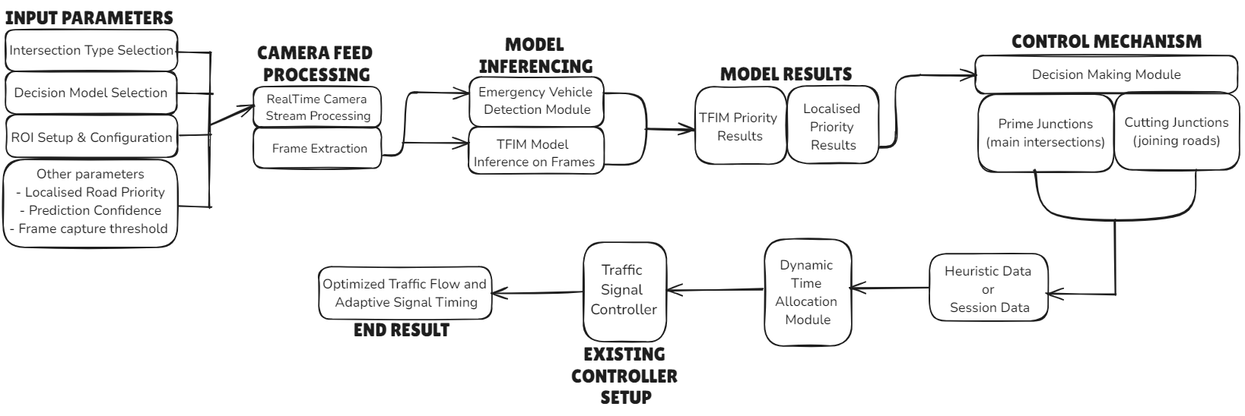
WORKFLOW
The required parameters are configured during initial setup for a particular intersection
Required frames are extracted from Real Time Camera Feed in regular intervals
Initial data for the decision making system is taken from these data
Any other constraints or approaches to be followed can be set in the heuristic data
Time is allocated based on the obtained results
The final results are sent as signals to the traffic controller
MAIN APPLICATION WORKING

Slide 5


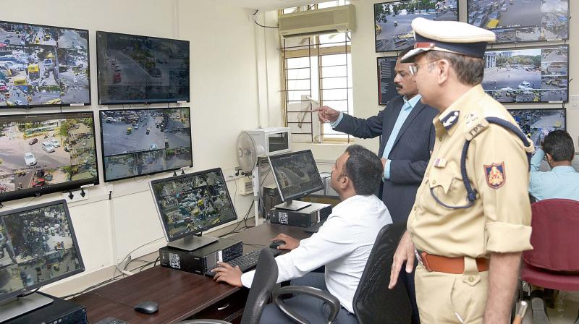

FEASIBILITY AND VIABILITY
FEASIBILITY ANALYSIS
Technical Feasibility:
Usage of Existing Technology – Computer Vision, AI and Real-Time Data Processing
Seamless Integration and Deployment with existing systems.
Develop a fail-safe mechanism to revert back to traditional traffic light control
Economic Feasibility:
Cost Efficiency
No requirements for special sensors and actuators
Operational Feasibility:
Availability of emergency case support
Real-time Data Processing and cloud infrastructure
User Acceptance – Users are likely to welcome a system that reduces delays and travel times
POTENTIAL CHALLENGES
Uniformity in Camera position
Use of parallel processing power
STRATEGIES TO OVERCOME CHALLENGES
Standardize the setup of camera and its position
Equipping with cloud based architecture for better utility
@SIH Idea submission
5

Slide 6

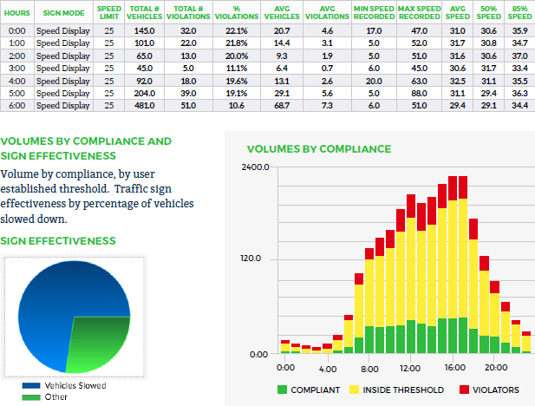
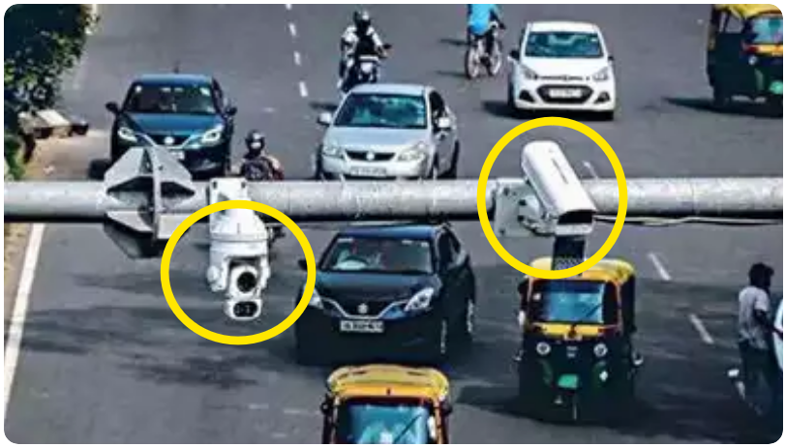

IMPACT AND BENEFITS
POTENTIAL IMPACT
- Impact on Urban Commuters
- Reduced Travel Time
- Improved Road Safety
- Impact on Traffic and Transportation Authorities
- Efficient Overall Traffic Management
- Improved Decision Making and Resource Allocation
- Availability of Traffic related Analytical Data
- Scalable Integration with existing Smart City initiatives
- Impact on Public Transportation Users
- Improved Service Reliability
- Reducing Delays and Congestions
BENEFITS
- Social Benefits
- Ensures fairness in Traffic, avoids prioritization
- Enhanced Quality of Life
- Sustainable use of fossil fuels
- Economic Benefits
- Fuel Cost Savings
- Increased Productivity
- Environmental Benefits
- Reduced Carbon Emissions
- Energy Efficiency
- Sustainable Ecosystem

Slide 7

RESEARCH AND REFERENCES
The following resources were referred:
Research paper titled “Design and Implementation of a Dynamic Intelligent Traffic Control System” - [link]
Research paper titled “A Dynamic Traffic Light Control Algorithm to Mitigate Traffic Congestion in Metropolitan Areas”- [link]
Research paper titled “Dynamic Traffic Control System with Reinforcement Learning Technique” - [link]
An open-sourced resource by Shubham001official - [link]
An open-sourced resource by gigahidjrikaaa (Universitas Gadjah Mada) - [link]
An open sourced resource by ericsherman4 - [link]

